Slide 1
TELEGRAM CHATBOT FOR FIXING DOCTOR APPOINTMENTS USING PYTHON
MIRA SOWNDARYA R
(311517104023)
SRUTI S
(311517104048)

Slide 2
OVERVIEW:
PROBLEM STATEMENT
ABSTRACT
INTRODUCTION
LITERATURE SURVEY
ARCHITECTURE
MODULES
UML DIAGRAMS
IMPLEMENTATION SCREENSHOTS
RESULTS
FUTURE SCOPE
REFERENCES

Slide 3
PROBLEM STATEMENT:
The appointment booking process in any firm involves the presence of a personal assistant or a receptionist. This process is often carried out either by meeting the concerned staff in person or contacting them through a telephone call. This situation can be improvised by automating this process through the creation of a chatbot.

Slide 4
ABSTRACT:
A chatbot is a piece of software that conducts a conversation via auditory or textual methods.
The proposed system is designed to automate the process of fixing appointments with doctors conveniently.
It takes in information such as the specialist they wish to consult and the date and time of the appointment.
It then books an appointment if the requested slot is available.

Slide 5
INTRODUCTION
A user friendly chatbot is created to ease the process of fixing doctor appointments.
A three tier architecture is aimed and the basic entities of this project include:
TELEGRAM- AS THE USER INTERFACE
PYTHON- AS THE DOMAIN LAYER
SQLITE3- DATABASE (THROUGH THE SQLITE BROWSER)

Slide 6
LITERATURE SURVEY
S.No. | Title of the paper | Inference
1 | Chatbot and bullyfree chat | Implementation using Python
2 | A platform for human-chatbot interaction using Python | Implementation using Python
3 | A conversational smart home assistant built on telegram and Google Dialogflow | Usage of Telegram as the user interface
4 | Design of E-Commerce chat robot for automatically answering customer questions | Usage of Telegram as the web server

Slide 7
LITERATURE SURVEY
CHATBOT AND BULLYFREE CHAT:
created using python and trained using Machine Learning.
using natural language processing with the help of machine learning algorithm
A PLATFORM FOR HUMAN-CHATBOT INTERACTION USING PYTHON:
web-based platform which will help in analysing Human-Chatbot interactions
agents which depend upon natural expressions implemented in Python

Slide 8
LITERATURE SURVEY
A CONVERSATIONAL SMART HOME ASSISSTANT BUILT ON TELEGRAM AND GOOGLE DIALOG FLOW:
a very user-friendly interface “Telegram” along with other technologies like Natural Language Processing, Machine Learning.
DESIGN OF E-COMMERCE CHAT ROBOT FOR AUTOMATICALLY ANSWERING CUSTOMER QUESTION:
Artificial Intelligence Chatbot by using Telegram Messenger
Periodically performs a request to Telegram server using a standard HTTP protocol(requests module in python).

Slide 9
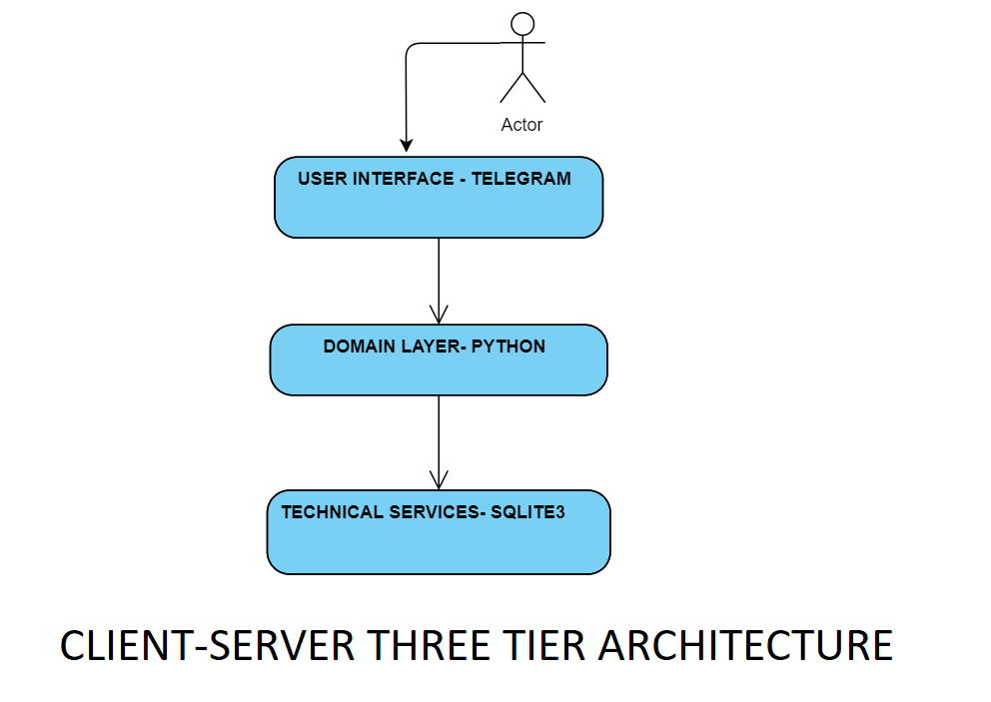
ARCHITECTURE

Slide 10
MODULES
Core module: This module takes in key information- date, time and the doctor. It then checks the availability of the doctor and blocks the slot.
Data module: This module extracts the key information from the conversation and passes it to the core module.
Integration module: This module is used to manage database connectivity.

Slide 11
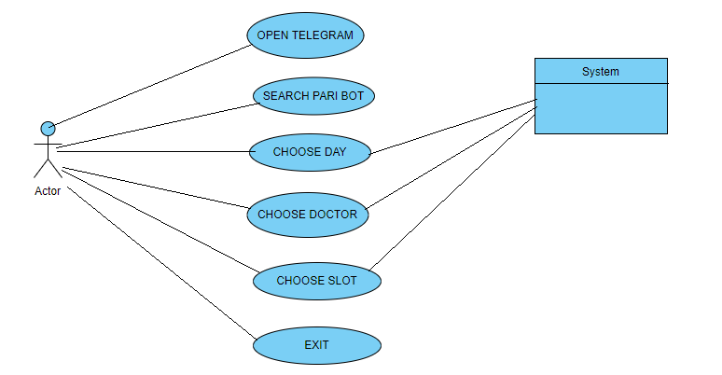
UML DIAGRAMS: USE CASE DIAGRAM

Slide 12
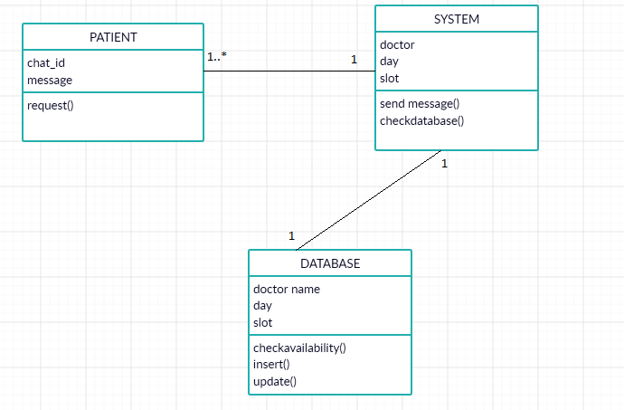
CLASS DIAGRAM:

Slide 13
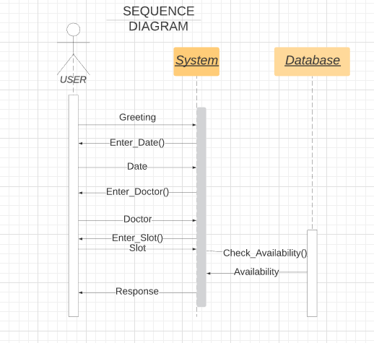
SEQUENCE DIAGRAM:

Slide 14
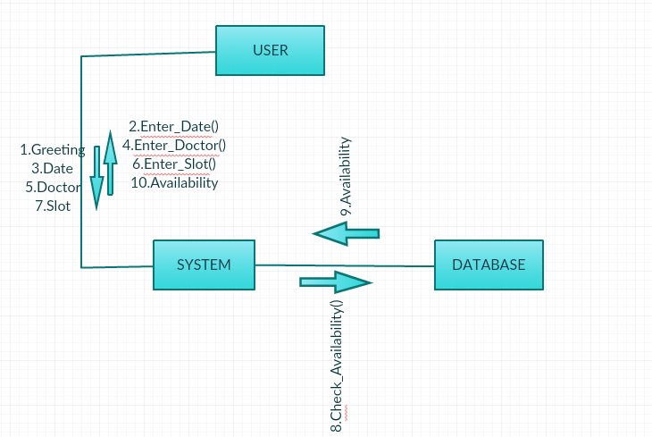
COLLABORATION DIAGRAM:

Slide 15
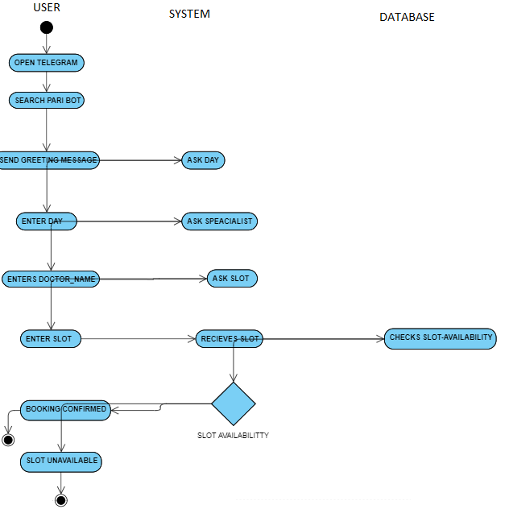
ACTIVITY DIAGRAM:

Slide 16
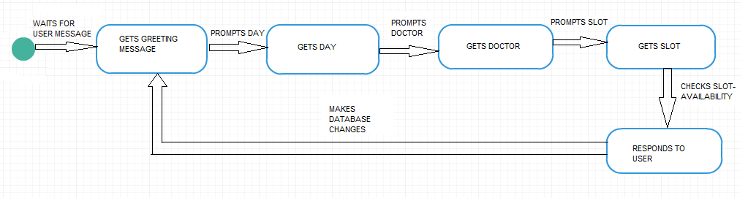
STATE CHART DIAGRAM:

Slide 17
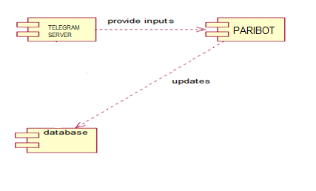
COMPONENT DIAGRAM:

Slide 18
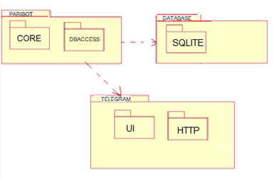
PACKAGE DIAGRAM:

Slide 19
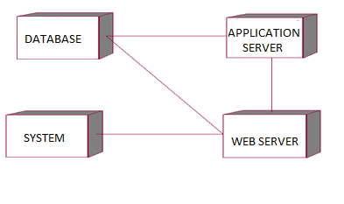
DEPLOYMENT DIAGRAM:

Slide 20
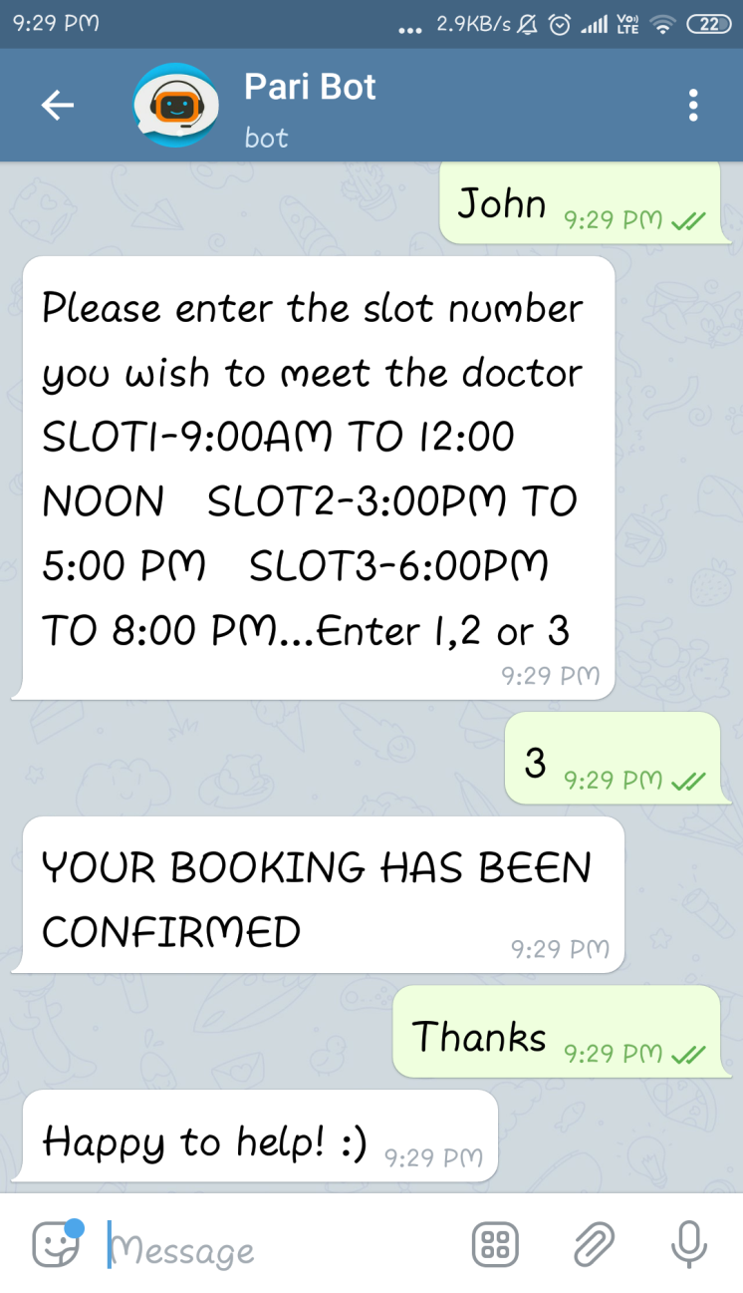
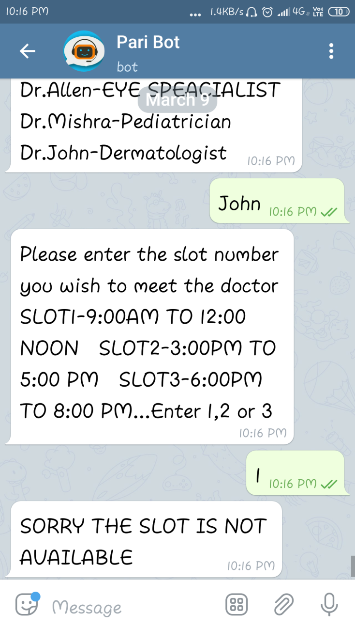
IMPLEMENTATION SCREENSHOTS:

Slide 21
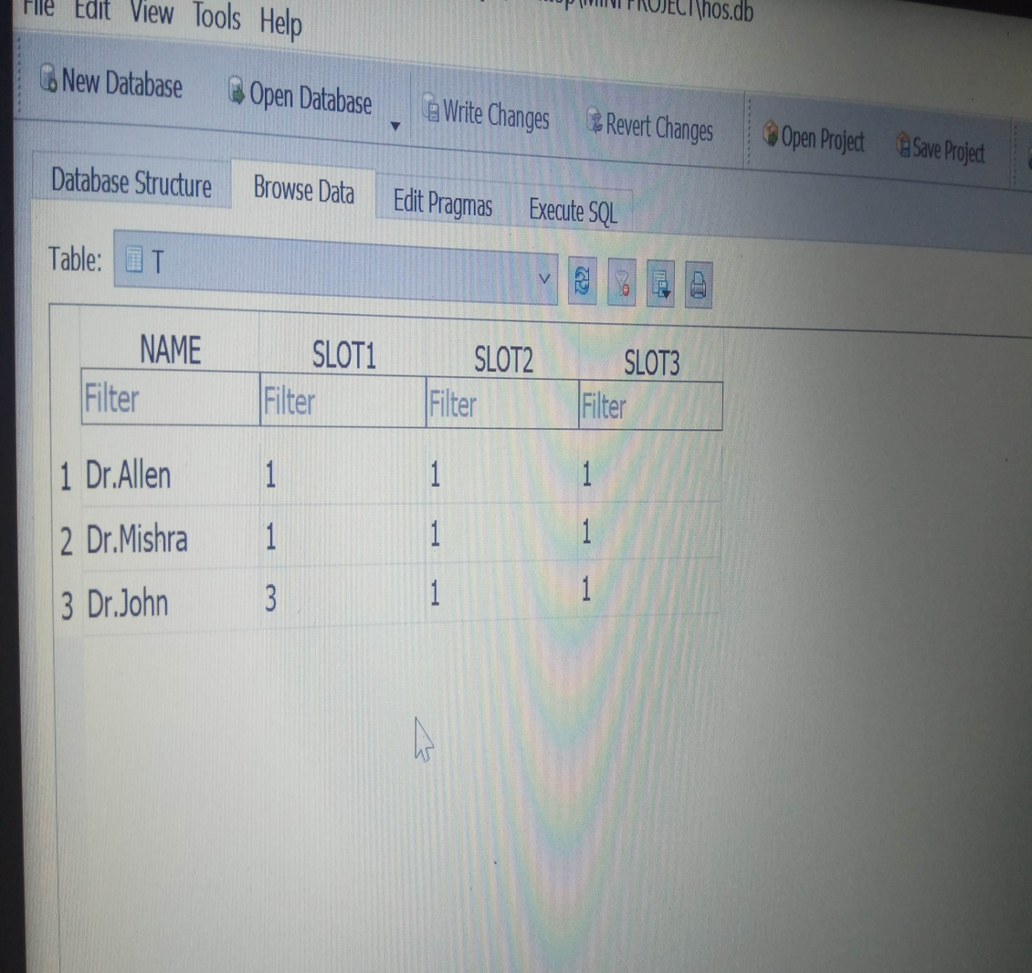
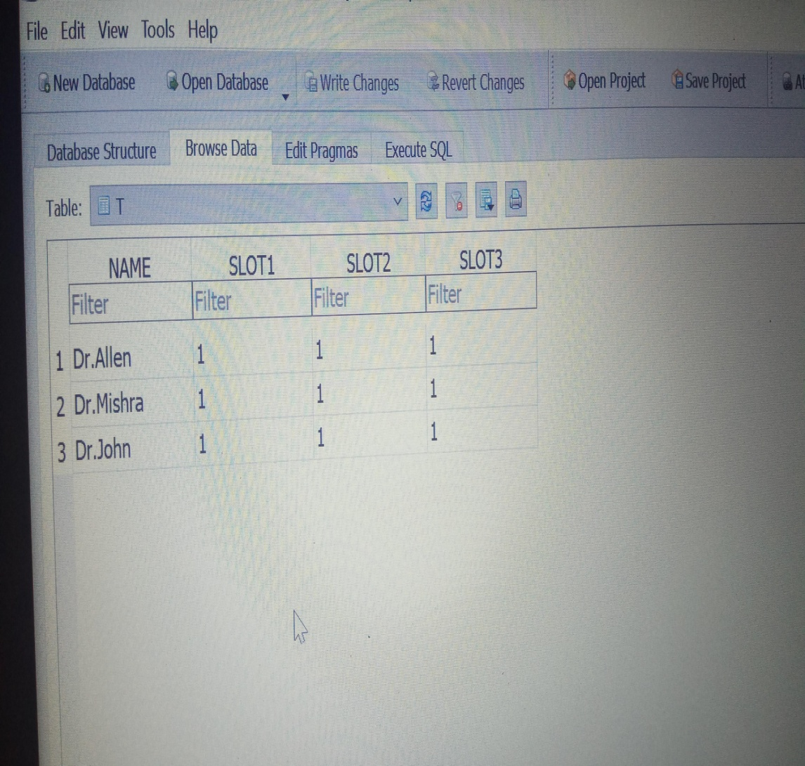
IMPLEMENTATION SCREENSHOTS:

Slide 22
FUTURE ENHANCEMENT:
In the future, the next step would ideally be to make a complete and universal model that the organizations can use to help them reduce their human resource costs.
Furthermore, can also be combined with other machine learning algorithms to create a highly robust and powerful system.
Various other concepts of machine learning can be implemented to improve the efficiency of the system as a whole.
The more the training data the more the accuracy.
Also interfaces independent to the hospital can be created for more privacy of the users.

Slide 23
CONCLUSION:
A Chatbot that takes information such as the doctor name, day of visit and the slot and books an appointment was developed.
The Bot was built on Telegram platform using the chat service provided by Telegram
The Telegram server forwards the updates to the application server and delivers the replies to the user.
The application server processes the updates and uses Sqlite database to check the availability and responds accordingly.
This method is very user friendly and and an appointment can be easily fixed through direct messages with the system-“the doctor chatbot” without much complications.

Slide 24
THANKYOU!

